Slide 1
3. Querying and Serialization
John P. McCrae
CT5166

Slide 2
Course structure
9th Sep | Introduction to Knowledge Graphs | 21st Oct | Inductive reasoning
16th Sep | Models for Knowledge Graphs | 28th Oct | KG Creation (no lab on Monday)
23rd Sep | Querying and Serialization | 4th Nov | KG Alignment
30th Sep | Schemas | 11th Nov | Publishing and Linked Open Data
7th Oct | Deductive reasoning | 18th Nov | Linguistic Linked Open Data
14th Oct | No Lecture | 25th Nov | Enterprise Knowledge Graphs

Slide 3
N-Triples and Turtle

Slide 4
RDF Elements
Recall the main elements
URIs
Denoted with angular brackets: <http://john.mccr.ae>
Blank Nodes
Denoted as: _:blank_node_id

Slide 5
RDF Elements
Literals
Denoted with double quotes: "abcdef"
Use ^^ to indicate a datatype, this must also be a URI: "10000"^^<http://www.w3.org/2001/XMLSchema#int>
Use @ to indicate a language (ISO 639 code) "This is an example"@en

Slide 6
N-Triples
Period at the end of each triple
Simplest RDF Serialization format:
subject predicate object .
Example:
<http://john.mccr.ae> <http://xmlns.com/foaf/0.1/name> "John P. McCrae"@en .
<http://john.mccr.ae> <http://xmlns.com/foaf/0.1/depiction> <http://john.mccr.ae/me.jpg> .

Slide 7

Simple N-Triples Example
<http://dbpedia.org/resource/Paris> <http://dbpedia.org/ontology/populationTotal> “2229621”^^<http://www.w3.org/2001/XMLSchema#nonNegativeInteger> .
<http://dbpedia.org/resource/Paris> <http://www.w3.org/1999/02/22-rdf-syntax-ns#type> <http://dbpedia.org/ontology/Location> .
<http://dbpedia.org/resource/Paris> <http://www.w3.org/1999/02/22-rdf-syntax-ns#type> <http://www.wikidata.org/entity/Q486972> .

Slide 8
Turtle
Extends N-Triples to make it more readable
Every N-Triples document is also a Turtle document
Prefixes can be declared with
@prefix pre: <http://www.example.com/> .
URIs are shortened with prefix
<http://www.example.com/foobar> ⇒ pre:foobar
CAREFUL!
No angular brackets for shortened URLs
Not <pre:foobar>

Slide 9
Prefix example
@prefix dbo: <http://dbpedia.org/ontology/> . @prefix dbp: <http://dbpedia.org/resource/> . @prefix rdf: <http://www.w3.org/1999/02/22-rdf-syntax-ns#> . @prefix xsd: <http://www.w3.org/2001/XMLSchema#> .
dbp:Paris dbo:populationTotal “2229621”^^xsd:nonNegativeInteger .
dbp:Paris rdf:type dbo:Location .
dbp:Paris rdf:type <http://www.wikidata.org/entity/Q486972> .
<http://dbpedia.org/resource/Paris> <http://dbpedia.org/ontology/populationTotal> “2229621”^^<http://www.w3.org/2001/XMLSchema#nonNegativeInteger> .
<http://dbpedia.org/resource/Paris> <http://www.w3.org/1999/02/22-rdf-syntax-ns#type> <http://dbpedia.org/ontology/Location> .
<http://dbpedia.org/resource/Paris> <http://www.w3.org/1999/02/22-rdf-syntax-ns#type> <http://www.wikidata.org/entity/Q486972> .

Slide 10
Continuations
Many triples may have the same subject or a property may have many values
We replace the period with a semicolon to repeat the subject and with a comma to repeat subject and property
<http://john.mccr.ae> foaf:name "John P. McCrae"@en .
<http://john.mccr.ae> foaf:knows <http://paulbuitelaar.net/> .
<http://john.mccr.ae> foaf:knows <https://www.mmll.cam.ac.uk/nhc30> .
<http://john.mccr.ae> foaf:name "John P. McCrae"@en ;
foaf:knows <http://paulbuitelaar.net/> ,
<https://www.mmll.cam.ac.uk/nhc30> .

Slide 11
Blank Nodes
Turtle introduces square brackets for blank nodes:
ex:foobar ex:prop _:b1 .
_:b1 ex:prop2 "foobar" .
Becomes
ex:foobar ex:prop [
ex:prop2 "foobar" ] .

Slide 12
List Syntax
RDF Lists can be compactly represented with round brackets ( )
ex:foobar ex:prop ( ex:elem1 ex:elem2 ) .
Replaces
ex:foobar ex:prop [
rdf:first ex:elem1 ;
rdf:rest [
rdf:first ex:elem2 ;
rdf:rest rdf:nil ] ] .

Slide 13
RDF Type
Also introduces a useful abbreviation a for <http://www.w3.org/1999/02/22-rdf-syntax-ns#type> .
For example:
dbpedia:Paris a dbo:Location .

Slide 14
Task
Translate Turtle into N-Triples

Slide 15
Task
@prefix ex: <http://www.example.com/> .
@prefix rdfs: <http://www.w3.org/2000/01/rdf-schema#> .
@prefix rdf: <http://www.w3.org/1999/02/22-rdf-syntax-ns#> .
ex:foobar a ex:Example ;
rdfs:label “foo bar”@en ;
ex:domain ex:example , ex:testing ;
ex:elements ( ex:ex1 ex:ex2 ) .

Slide 16
Other serializations

Slide 17
RDF/XML
The first (and canonical) model for representing RDF
But… it ain’t pretty!
<rdf:RDF xmlns:rdf="http://www.w3.org/1999/02/22-rdf-syntax-ns#"
xmlns:foaf="http://xmlns.com/foaf/0.1/">
<rdf:Description rdf:about="http://john.mccr.ae">
<foaf:name>John P. McCrae</foaf:name>
</rdf:Description>
</rdf:RDF>

Slide 18
RDFa
Default prefix for all URLs
Subject URL (relative)
Special syntax for rdf:type
Normal HTML Document with embedded:
<div vocab="http://xmlns.com/foaf/0.1/" typeof="Person" resource="/alice">
<p>
<span property="name">Alice Birpemswick</span>,
Email: <a property="mbox" href="mailto:alice@example.com">
alice@example.com</a>
</p>
</div>
Object URL (instead of text content)
@prefix : <http://xmlns.com/foaf/0.1/> .
</alice> a :Person ;
:name "Alice Birpemswick" ;
:mbox <mailto:alice@example.com> .

Slide 19
JSON
JSON is a widely used format
Web (RESTful) services
Great support in many programming languages
Javascript...duh!
Object mapping libraries: Jackson (Java), Serde (Rust), JsonPickle (Python)
Databases
MongoDB, Elasticsearch, CouchDB etc...

Slide 20
JSON-LD
Not just a way to serialize RDF in JSON
Allows (nearly) any JSON document to be understood as RDF
{
"@context": "https://json-ld.org/contexts/person.jsonld",
"@id": "http://dbpedia.org/resource/John_Lennon",
"name": "John Lennon",
"born": "1940-10-09",
"spouse": "http://dbpedia.org/resource/Cynthia_Lennon"
}
Context document describes conversion to RDF
Link to external document OR JSON object
Normal JSON document
https://json-ld.org/playground/

Slide 21
JSON-LD Context - Assigning URIs
Indicates that name is short for this URI
{
"@context": {
"name": "http://schema.org/name",
"image": {
"@id": "http://schema.org/image",
"@type": "@id" }
},
"name": "John",
"image": "http://john.mccr.ae/me.jpg"
}
Interpret the values of this property as URI
_:b1 <http://schema.org/image> <http://john.mccr.ae/me.jpg> .
_:b1 <http://schema.org/name> "John" .

Slide 22
CSV on the Web
Format for tabular data, built on top of JSON-LD
Allows for annotation of comma-separated values (CSV) data and easy mapping to RDF

Slide 23
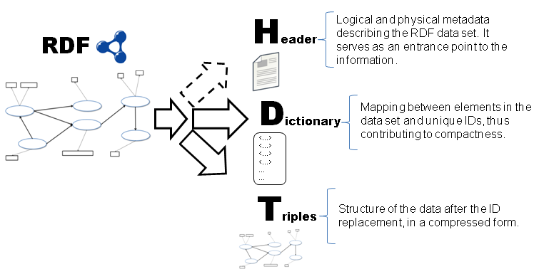
Binary Formats
RDF serializations are still quite verbose
Why should I use RDF when CSV/JSON is more efficient?
How about an RDF format that is small and fast to use?

Slide 24
Task
Write an RDF document and convert between
Turtle
N-Triples
RDF/XML
JSON-LD
Bonus: Install rdf2hdt and convert to HDT
https://www.easyrdf.org/converter

Slide 25
SPARQL
Basics

Slide 26
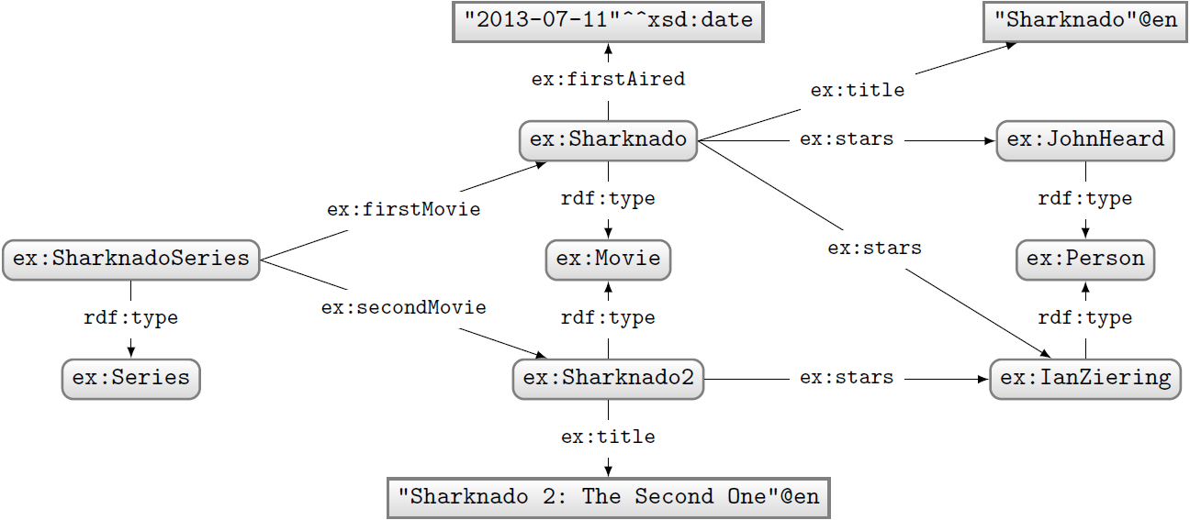
SPARQL Protocol and RDF Query Language
How to ask: “Who stars in ‘Sharknado’?”

Slide 27
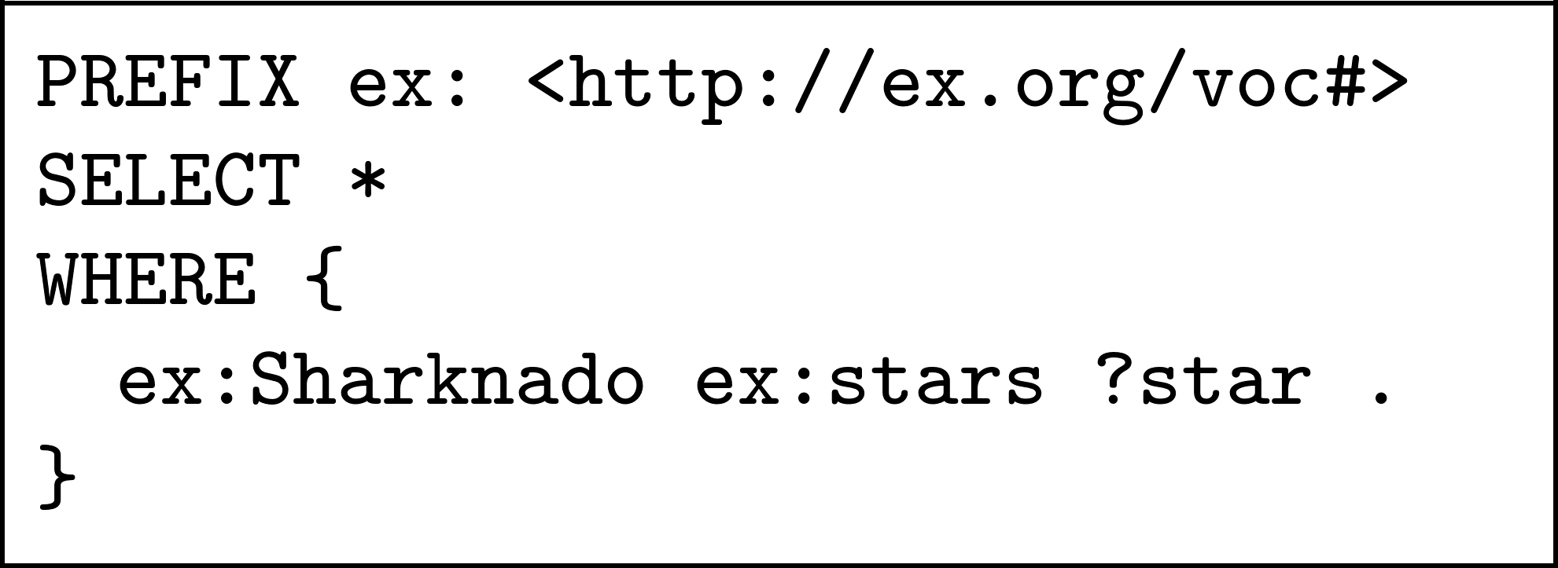
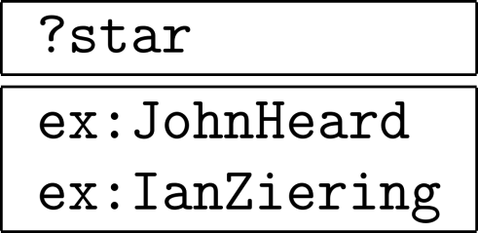
SPARQL Protocol and RDF Query Language
Query:
Solutions:

Slide 28
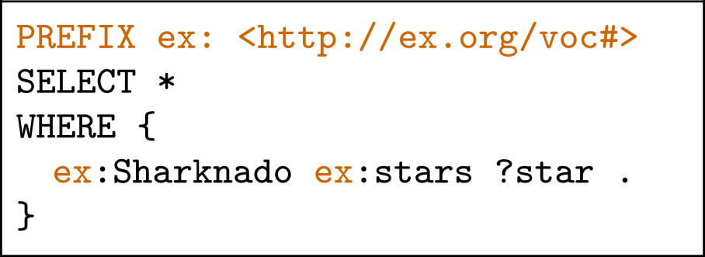
SPARQL Prefix Declarations
Just like Turtle… with a different syntax!

Slide 29
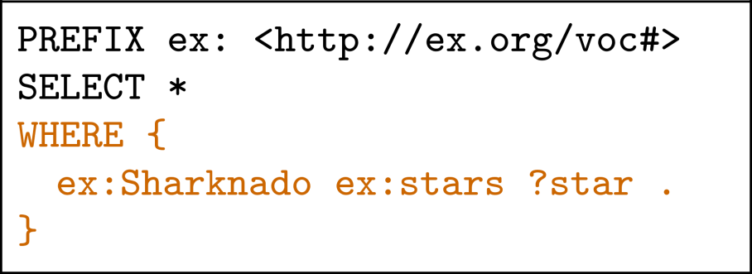
SPARQL WHERE clauses
Variables indicated with ? or $
Query:
Solutions:
WHERE is optional

Slide 30
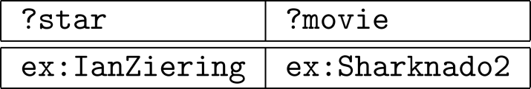
SPARQL WHERE clauses
Repeated variable is called a ‘join’ variable
Query:
Solutions:
PREFIX ex: <http://ex.org/voc#>
SELECT *
WHERE {
ex:SharnadoSeries ex:secondMovie ?movie.
?movie ex:stars ?star .
}

Slide 31
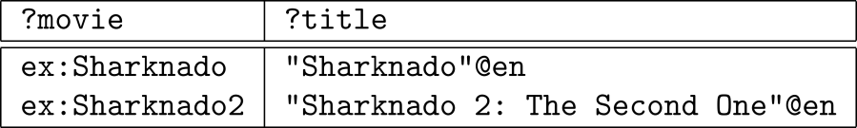
Disjunctions
Query:
Solutions:
PREFIX ex: <http://ex.org/voc#>
SELECT *
WHERE {
{ ex:SharnadoSeries ex:firstMovie ?movie. }
UNION
{ ex:SharnadoSeries ex:secondMovie ?movie. }
?movie ex:title ?title .
}

Slide 32
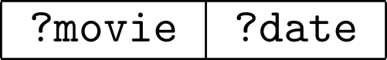
Filters
Query:
Solutions:
PREFIX ex: <http://ex.org/voc#>
PREFIX xsd: <http://www.w3.org/2001/XMLSchema#>
SELECT *
WHERE {
?movie ex:firstAired ?date .
FILTER(?date > “2015-01-02”^^xsd:date)
}
No results!

Slide 33
Solution Modifiers
ORDER BY ?a
Order by a single result
Descending order. For ascending order: ORDER BY ASC(?a)
LIMIT n
Return at most n results
OFFSET m
Discard first m results

Slide 34
Task
Write SPARQL queries:
Which people are in the dataset?
Who starred in either Sharknado movie?
When did the first Sharknado movie come out?

Slide 35
Colab Code
!pip install rdflib
import rdflib
from rdflib import Graph
import io
g = Graph()
g.load(io.StringIO("""@prefix ex: <http://www.example.com#> .
@prefix xsd: <http://www.w3.org/2001/XMLSchema#> .
ex:SharknadoSeries ex:firstMovie ex:Sharknado ;
ex:secondMovie ex:Sharknado2 ;
a ex:Series .
ex:Sharknado ex:firstAired "2013-07-11"^^xsd:date ;
ex:title "Sharknado"@en ;
ex:stars ex:JohnHeard, ex:IanZiering ;
a ex:Movie .
ex:Sharknado2 ex:title "Sharknado 2: The Second One"@en ;
ex:stars ex:IanZiering ;
a ex:Movie .
ex:JohnHeard a ex:Person .
ex:IanZiering a ex:Person ."""), format="turtle")
results = g.query("""PREFIX ex: <http://www.example.com#>
SELECT * WHERE {
?person a ex:Person .
?movie ex:stars ?person
}""")
for r in results:
print(r)

Slide 36
Query Types

Slide 37
Query types: SELECT
Choose the variables we wish to return
Query:
Solutions:
PREFIX ex: <http://ex.org/voc#>
SELECT ?movie
WHERE {
?movie ex:stars ?actor .
}
?movie
ex:Sharknado
ex:Sharknado
ex:Sharknado2

Slide 38
Query types: SELECT DISTINCT
Remove duplicate results
Query:
Solutions:
PREFIX ex: <http://ex.org/voc#>
SELECT DISTINCT ?movie
WHERE {
?movie ex:stars ?actor .
}
?movie
ex:Sharknado
ex:Sharknado2

Slide 39
Query types: ASK
Returns true if there are any results
Query:
Solutions:
PREFIX ex: <http://ex.org/voc#>
ASK
WHERE {
?movie ex:stars ex:JohnHeard .
}
true

Slide 40
Query Type: CONSTRUCT
Build a graph from the results
Query:
PREFIX ex: <http://ex.org/voc#>
CONSTRUCT {
?star1 ex:knows ?star2
} WHERE {
?movie ex:stars ?star1, ?star2
FILTER(?star1 != ?star2)
}
Solution:
ex:JohnHeard ex:knows ex:IanZiering .
ex:IanZiering ex:knows ex:JohnHeard .

Slide 41
Query Type: DESCRIBE
Describe queries return a ‘description’ of a single entry
Standard is imprecise about what a description is, but normally returns all triples using element
PREFIX ex: <http://ex.org/voc#>
DESCRIBE ex:Sharknado

Slide 42
Task
Try a SELECT DISTINCT, CONSTRUCT, ASK and DESCRIBE query using RDFlib

Slide 43
More query features

Slide 44
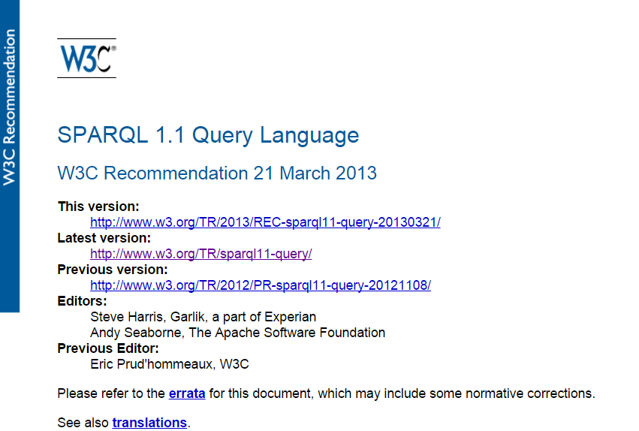
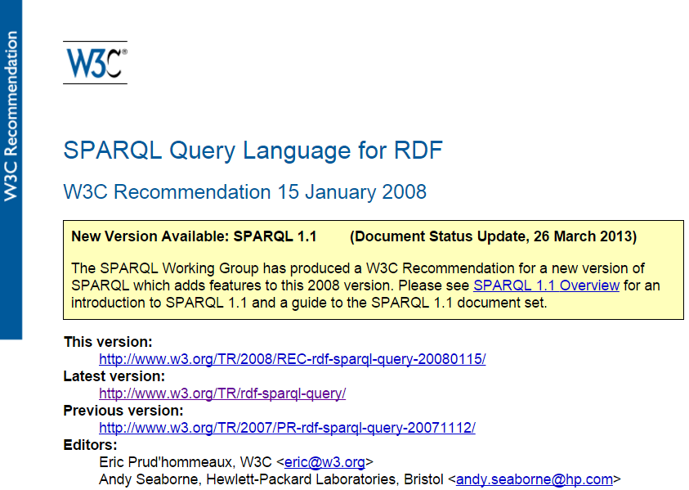
SPARQL 1.1

Slide 45
Property paths
PREFIX ex: <http://ex.org/voc#>
SELECT *
WHERE {
ex:SharnadoSeries
ex:secondMovie/ex:stars ?star .
}
Solutions:
?star
ex:IanZiering

Slide 46
More Property Paths
prop1|prop2: Either prop1 or prop2
prop1+: prop1 repeated 1 or more times
prop1*: prop1 repeated 0 or more times
prop1?: prop1 repeated 0 or 1 times
^prop1: prop1 reversed
?x ^prop1 ?y is the same as ?y prop1 ?x
!prop1: Any property except prop1
Often combined as !(prop1|prop2|prop3)

Slide 47
Task
!pip install rdflib
from rdflib import Graph
from io import StringIO
g = Graph()
g.load(StringIO("""
<file:foo> <file:prop> (
<file:e1> <file:e2> <file:e3> ) ."""),
format="turtle")
Write a SPARQL query to find any element in a list using property paths

Slide 48
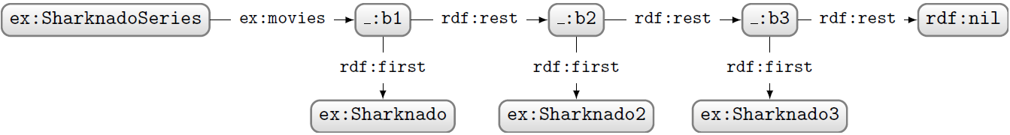
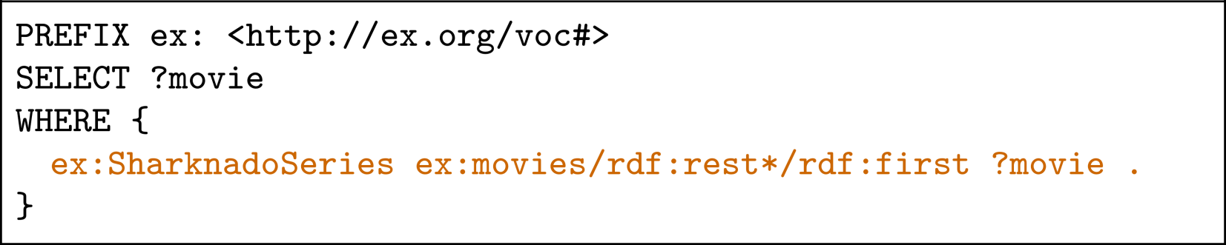
Property Paths
How to ask: “Which movies are in the Sharknado series?”
Query:

Slide 49
Updating

Slide 50
Inserting data
Into default graph
PREFIX ex: <http://ex.org/voc#>
INSERT DATA {
ex:SharknadoSeries ex:secondMovie ex:Sharknado2
}
Into specific graph
PREFIX ex: <http://ex.org/voc#>
WITH <http://www.example.com/sharknado>
INSERT DATA {
ex:SharknadoSeries ex:secondMovie ex:Sharknado2
}
PREFIX ex: <http://ex.org/voc#>
INSERT DATA {
GRAPH <http://www.example.com/sharknado> {
ex:SharknadoSeries ex:secondMovie ex:Sharknado2
}
}

Slide 51
Deleting data
PREFIX ex: <http://ex.org/voc#>
DELETE DATA {
ex:SharknadoSeries ex:secondMovie ex:Sharknado2
}
INSERT and DELETE can be further specified with a WHERE clause
PREFIX ex: <http://ex.org/voc#>
DELETE {
ex:SharknadoSeries ex:secondMovie ?movie
} WHERE {
?movie ex:stars ex:IanZiering
}

Slide 52
Adding/removing datasets
LOAD <file:sharknado.ttl>
INTO GRAPH <http://www.example.com/sharknado>
Load from a file (or remote URL)
Remove all triples from a graph
CLEAR GRAPH <http://www.example.com/sharknado>
CREATE GRAPH <http://www.example.com/sharknado>
Create an empty graph
Delete graph and all triples
DROP GRAPH <http://www.example.com/sharknado>

Slide 53
Adding/removing datasets
ADD <http://www.example.com/sharknado2>
TO GRAPH <http://www.example.com/sharknado>
Add all triples from one graph to another
Like ADD, but also clear the target graph if it exists
COPY <http://www.example.com/sharknado2>
TO GRAPH <http://www.example.com/sharknado>
MOVE <http://www.example.com/sharknado2>
TO GRAPH <http://www.example.com/sharknado>
Drop and move the source graph (clear target graph if it exists)

Slide 54
Task
Try to add data to a RDFlib Graph using update queries
NB. call graph.update() not graph.query()

Slide 55
Summary
Turtle is a “terse” format for representing RDF
Other formats also exist and may be more appropriate for some applications
RDFa for web pages
JSON-LD for web services
HDT for performance
SPARQL is a query language for RDF
Based on SQL

